Slide 1



RT-Cloud 2024 Dr. George Violettas, July 2024
Copyright © SYSGO RESTRICTED

Slide 2
George Violettas
Ph.D. in Network Control & Security for the Internet of Things
R&D Department Deputy Manager
SYSGO GmbH, Frankfurt, Germany
Previously
Assistant Professor, Alfaisal University, Saudi Arabia
Senior Lecturer & Head of ICT Department, Applied Engineering College, Saudi Arabia

Slide 3

Presentation Abstract
Cloud computing offers scalable resources but introduces latency and security concerns.
Edge computing addresses latency and security by processing data closer to the source, but it faces challenges in maintaining consistency, reliability, and connectivity across constrained, distributed, and potentially mobile nodes.
Real-time operating systems (RTOS) offer robust, efficient, and secure solutions in the rapidly evolving landscape of cloud/edge computing
RTOSs have to balance resource limitations with high performance and security
Challenges include data integrity, complexity, and interoperability while satisfying safety/security standards.
Applicable domains include autonomous vehicles, industrial automation, and safety-critical infrastructure

Slide 4
TOPICS
1. SYSGO Short Introduction
2. PikeOS Introduction
3. SIL4 CLOUD: Digitale Schiene Deutschland
3.1 Cloud Solutions: SYSGO in IPCEI-CIS Program
Railway Use case
4. Secure Cloud/Edge Gateway: From concept to product
5. Safe Secure Smart Cloud Gateway Open Questions

Slide 5
SYSGO

Slide 6

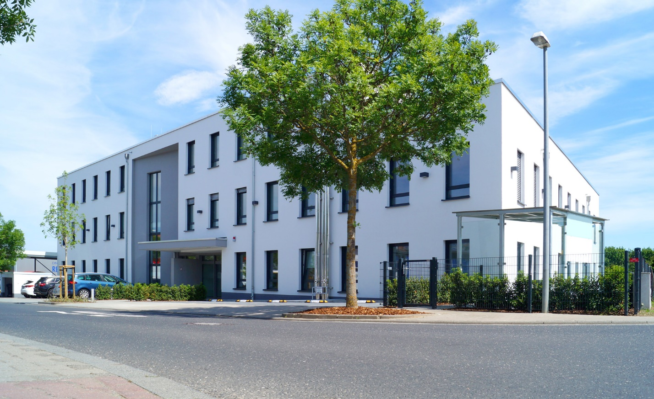
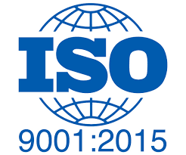
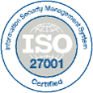
Developing locally Acting globally
One of the leading providers in Europe
Operating System (OS) for embedded systems
Safe & Secure Technologies and Services
For high-end software solutions in any IoT device
Founded in 1991
Almost 30 years of experience in certification of Safety-critical systems
Member of the Thales Group
SYSGO Headquarters Germany

Slide 7

Embedded Performance For Critical Systems
PikeOS
Certified hard real-time OS (Separation Kernel with type-1 hypervisor)
ELinOS
Embedded Linux distribution
Field-proven for Avionics, Automotive, Defense, Industrial, Medical, Railway, and Space applications
Seamless customer product development and management:
System architecture and Security approach
Hardware integration
Long-term customer support
Tools and services to cover the full product life cycle

Slide 8
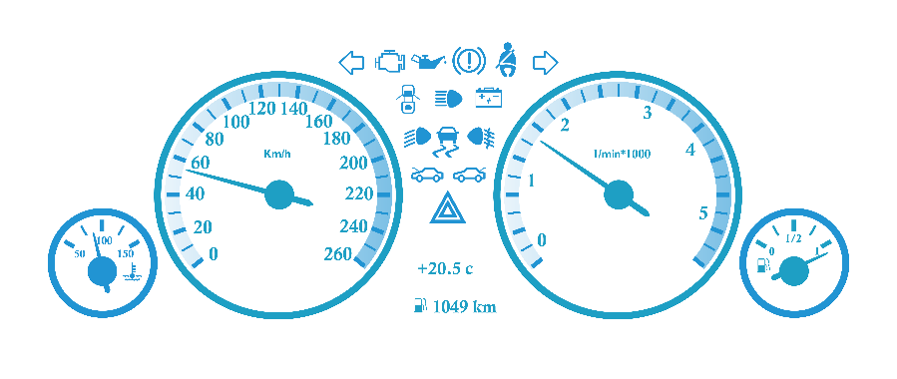

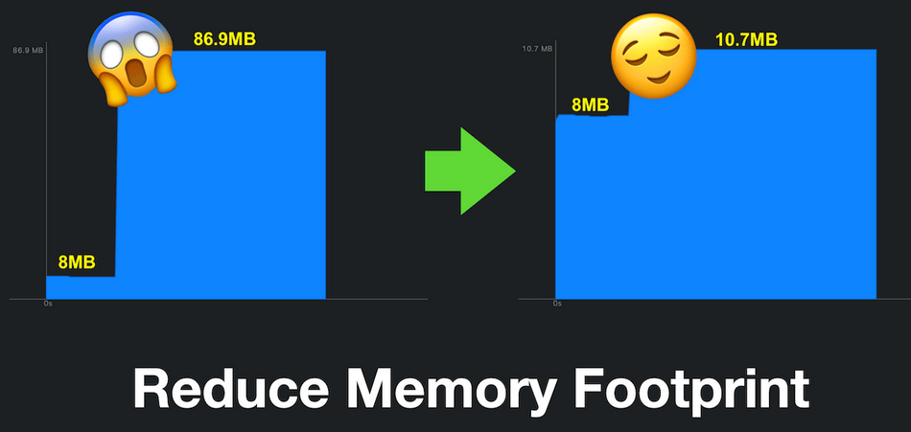


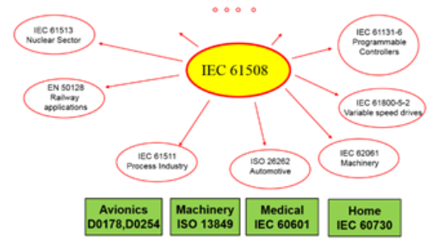
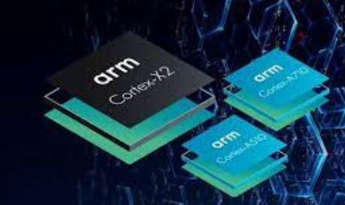
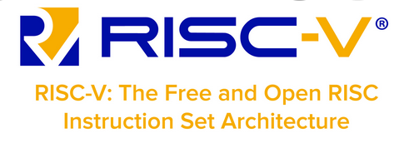

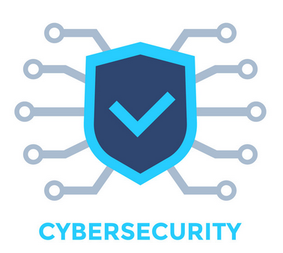
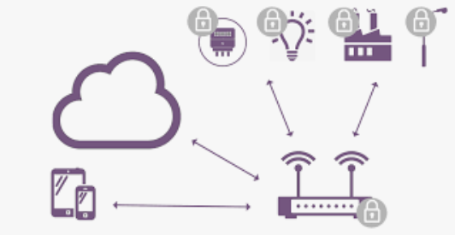
Research & Technology Department
SASVI, TRISTAN, ISOLDE, REBECCA
SuzECK
Automotive
HAL4SDV
(SAS +GmbH)
R&T:
Strategic Focus
LoliPop-IOT
IPCEI-CIS:SuzECK-SCP
(Safe Compute Platform)
SIoTGateway, ProSeCA

Slide 9
PikeOS

Slide 10
Separation kernel fundamental concept
MILS system
MILS: Multiple Independent Levels of Security and Safety:
System architecture to provide independent execution environments (partitions).
Partition
P2
Partition
P4
Partition
P1
Partition
P3
Partition
P5
Partition:
Independent execution environment encapsulating application(s) and/or data.
Unit of separation with respect to resource allocation (CPU time, processing core/CPU affinity, memory, application binaries, data, network, communication objects).
Can be statically configured at system integration/manufacturing time of an embedded device
Separation kernel: Enforces the resource allocation policy.
[1] Tverdyshev, Sergey, Holger Blasum, Bruno Langenstein, Jonas Maebe, Bjorn De Sutter, Bertrand Leconte, Benoît Triquet, et al. “MILS Architecture,” September 30, 2013. https://doi.org/10.5281/zenodo.45164.
Separation Kernel
Hardware
Legend:
Untrusted
Trusted
Notes:
BUT how to make more safe and secure systems? One approach is using a MILS system.
MILS means Multiple Independent Levels of Security and Safety which is the technical Foundation of PikeOS.
It consists of a Special System Architecture with independent execution environments. > so called partitions.
Differences. Separation is done at system integration time. , access to network - there can be statically configured
MILS system with 5 Partitions, Untrusted partiitons (faulty & malicious) do not harm the trusted partitions, without interference
Communication channels are defined forehand
If an attacker attacks P1 he would only be able to use the the pre-defined comm. channels
Differences to Linux
Resource partitioning: Static allocation at system startup. Time Partitioning: Strict timed sliced bases scheduling
Zu erwartende Frage: Was ist der Unterschied zwischen einer Partition (mit execution environment) und einem Linux Prozess? -> Resource partitioning: Static allocation at system startup. Time Partitioning: Strict timed sliced bases scheduling

Slide 11
Multiple Independent Levels of Security (MILS) High-Assurance Security Architecture at OS Level
Foundation for a MILS system:
Employes one or more separation mechanisms to maintain assured data and process separation. Usage of a SEPARATION KERNEL is one of the possible ways to achieve the MILS core capability
Low-criticality Partition
Medium-criticality Partition
High-criticality Partition
Application plane
Refinement
MILS induced abstraction
MILS Architecture
Low-criticality Partition
Medium-criticality Partition
High-criticality Partition
MILS Platform (Separation Kernel)
Hardware (CPUs, memory, and devices)
Resource plane
Network
Actuator
Notes:
Definition: high-assurance security architecture based on the concepts of separation and controlled information flow; implemented by separation mechanisms that support both untrusted and trustworthy components; ensuring that the total security solution is non-bypassable, evaluatable, always invoked and tamperproof.
(https://en.wikipedia.org/wiki/Multiple_Independent_Levels_of_Security)

Slide 12

single product / multiple features
Up to 255 resource partitions
Embedded, Hard Real-Time OS
Hard real-time
Preemptive - guarantees fast response
Deadline monitoring by embedded HEALTH MONITOR subsystem
Partitioning as per MILS approach
Separated containers (partitions)
Software is executed independently from each other
Virtualized guest operating systems inside partitions
Main principle for safety and security
Mixed Criticality
Certifiable
Drivers can run in user space
Guest
Operating
System
Guest
Runtime
Environment
PikeOS
Native
Drivers
Multiple Independent Levels of Security (MILS)
PikeOS Separation Kernel
Target Boot Loader
Hardware
CPU(s)
RS-485
RS-232
Ethernet
Graphics
...
Type 1 HyperVisor

Slide 13
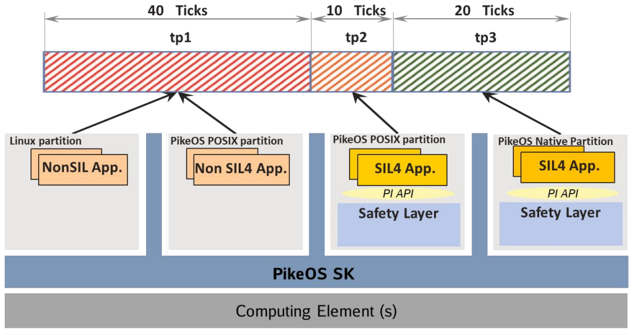
Time partitioning scheduling of mixed-critical applications

Slide 14
SIL4 CLOUD CONCEPTS

Slide 15

SIL4 CLOUD
Certifiable IT platform in private cloud environments.
Hosts safety-critical railway applications.
SIL4 (Safety Integrity Level 4): Highest safety and reliability level in railway systems (CENELEC norms).
Key design principles:
Run SIL (4) applications with basic integrity functional applications.
Consolidates different computing nodes in a data centre.
Envisioned infrastructure:
Multiple data centres.
Network interconnections between data centres and field elements.
High availability and stability requirements.
Low latencies and scalability for numerous connected field elements.
Notes:
A SIL4 Cloud is a certifiable IT platform in private cloud environments, which will host safety-critical railway applications. According to CENELEC functional safety norms, SIL4 (Safety Integrity Level 4) represents the highest level of safety and reliability in the railway system.
One of the key design principles of SIL4 Cloud is to run SIL applications along with basic integrity functional applications side by side. This helps to consolidate different computing nodes in a data centre.
At its core, the envisioned infrastructure required to host the SIL4 Cloud consists of multiple data centres, their network interconnection as well as network connections between the data centres and the field elements that need to be controlled. For the data centres as well as the networks, a very high degree of availability and stability is required in order to satisfy the requirements of a SIL4 Cloud. In addition, low latencies and scalability must be guaranteed for a large number of connected field elements.

Slide 16

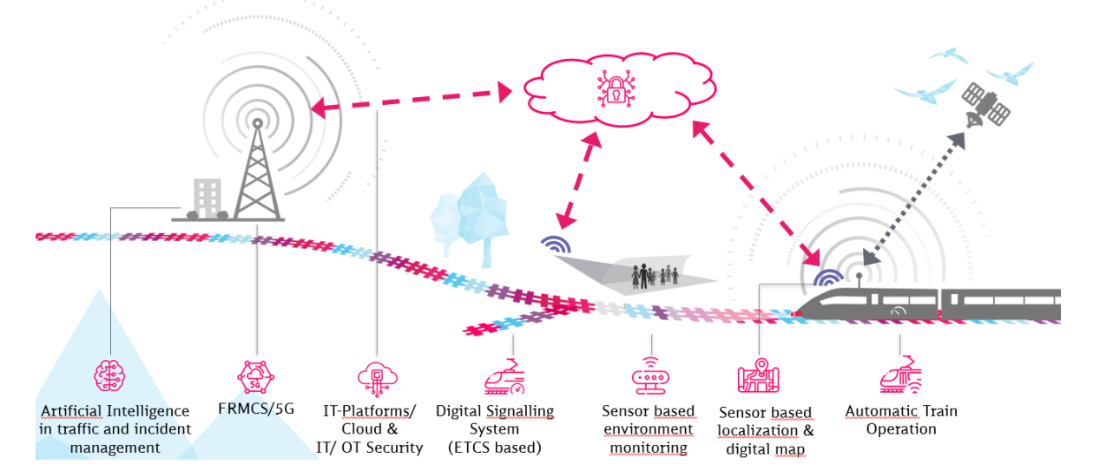
SIL4 CLOUD research report (14-Sep-2022)
https://digitale-schiene-deutschland.de/Downloads/Report%20-%20SIL4%20Cloud.pdf

Slide 17
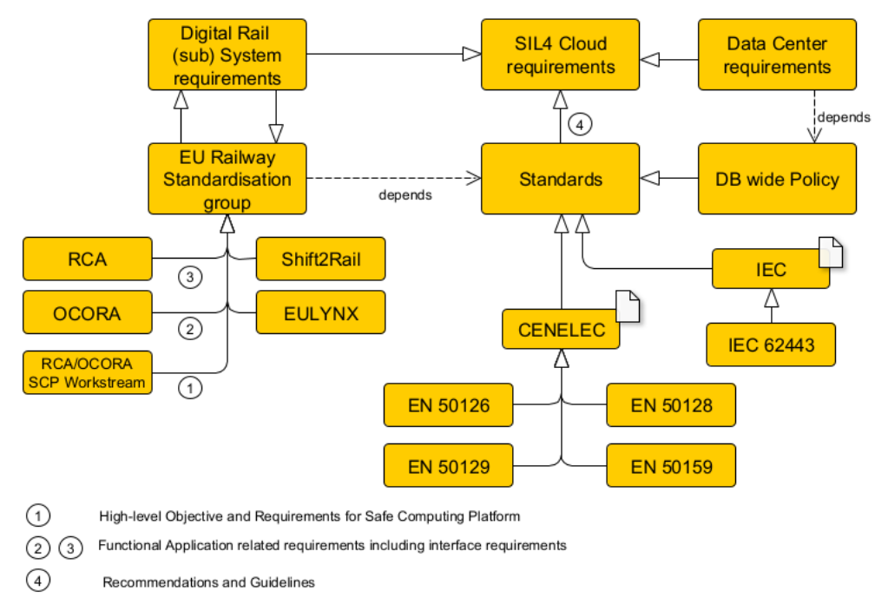
Sil4cloud relevant standards
A SIL4 Cloud has to fulfill requirements and constraints from many different stakeholders and sources:
legislative norms on safety
standards from European Railway standardization groups for:
interoperability
data security
organizational objectives

Slide 18
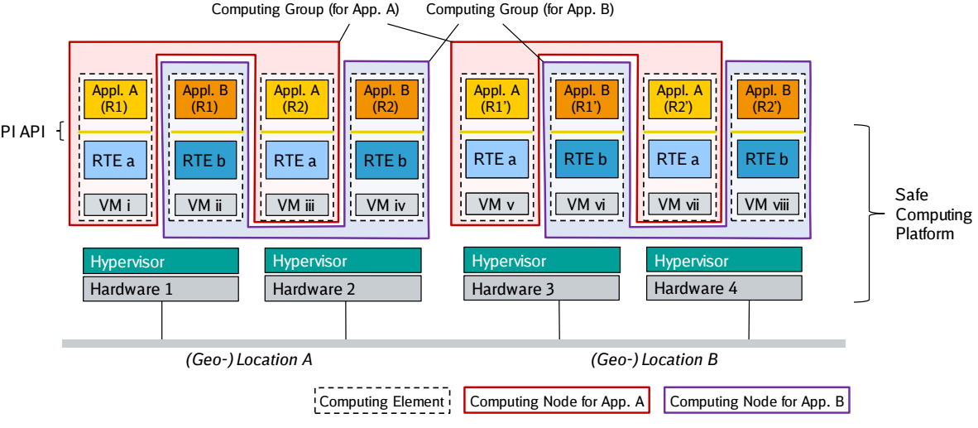
Deployment example

Slide 19
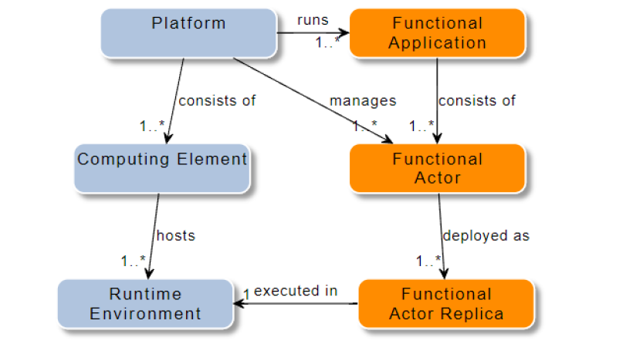
OCORA PI API
Acronyms
OCORA = Open CCS On-board Reference Architecture
CCS = Command, control and signaling
PI Platform-independent API
OCORA PI API in a nutshell
Application developers’ interface
POSIX subset for run-time environments
Communication between applications via flows
Applications are (optionally) structured into functional actors
System integrators’ interface
Configure redundancy of execution environments as needed (replicas) on computing elements
Error handling
Functionality of OCORA PI API implementation:
Isolation
Transparent handling of redundancy, e.g., DDS publisher/subscriber
https://github.com/OCORA-Public/Publications/blob/master/00_OCORA%20Latest%20Publications/Latest%20Release/OCORA-TWS03-030_SCP_Specification_of_the_PI_API_between_Application_and_Platform.pdf

Slide 20
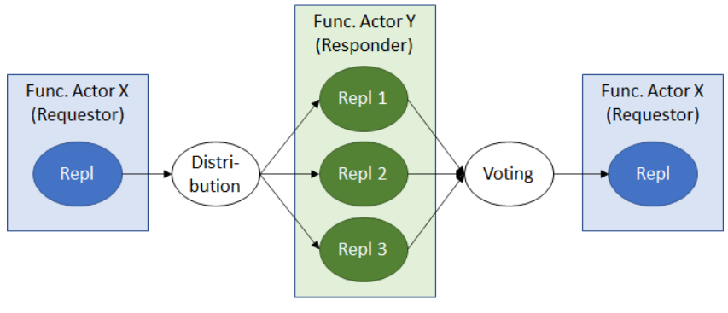
data Flow Distribution
Open Research Questions:
How to implement Voting:
How to implement Replicas:
Is there a need for the replica of the replicas before voting (HW)?
What about replicating the voters?

Slide 21
IPCEI-CIS (Suzeck)

Slide 22
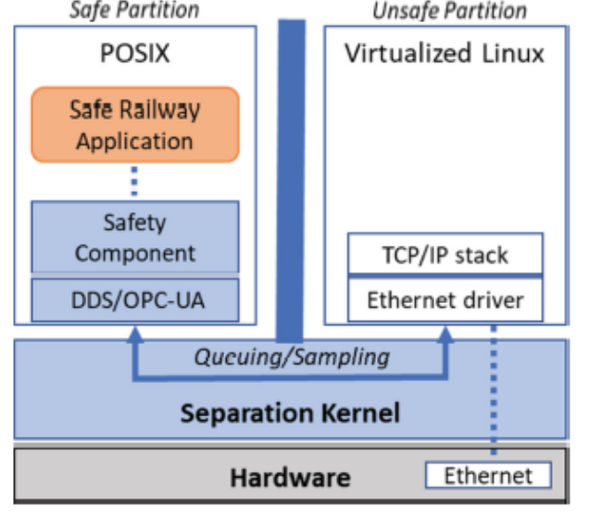
Non-Safety critical vs safe communication
Example of a safe communication architecture based on DDS/OPC UA and Separation Kernel
Non safety-critical implementation (including open-source reference implementation)
Container 1
Container 2
OCORA PI library
OCORA PI library
Linux + Docker

Slide 23
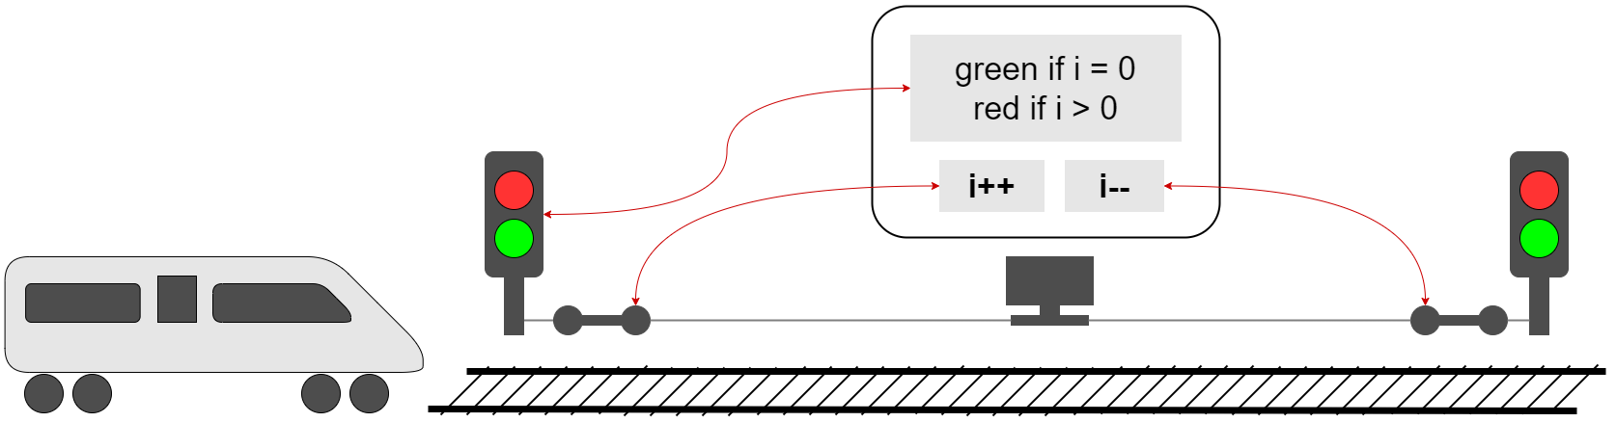
SuzECK
Secure, Safe, Authorized & Certifiable Edge & Cloud Key Components
Simplified Use-Case

Slide 24
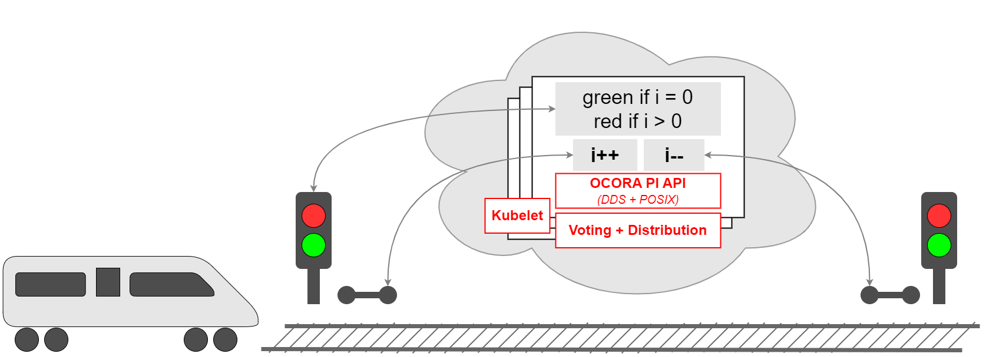
SuzECK
Secure, Safe, Authorized & Certifiable Edge & Cloud Key Components
Software Stacks for Functional Application
Container

Slide 25
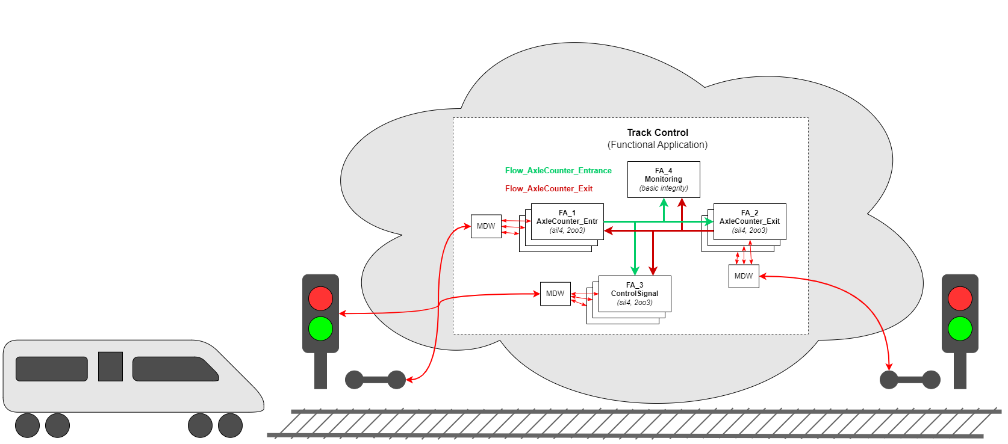


SuzECK
Secure, Safe, Authorized & Certifiable Edge & Cloud Key Components
Functional Actors + Flows

Slide 26
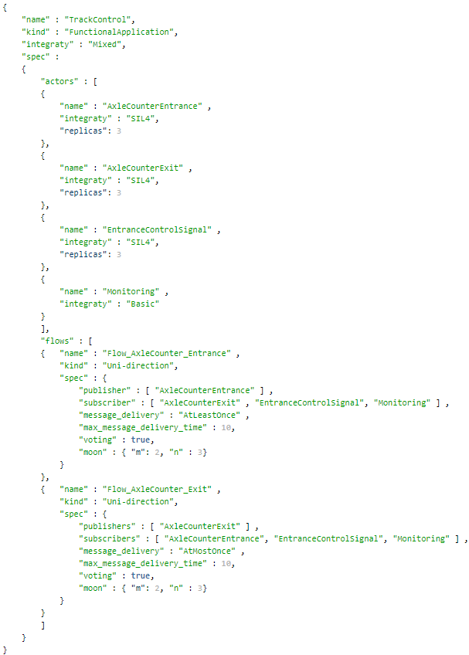
SuzECK
Secure, Safe, Authorized & Certifiable Edge & Cloud Key Components
Design to JSON configuration

Slide 27
LoliPoP-IoT (Horizon EU)

Slide 28


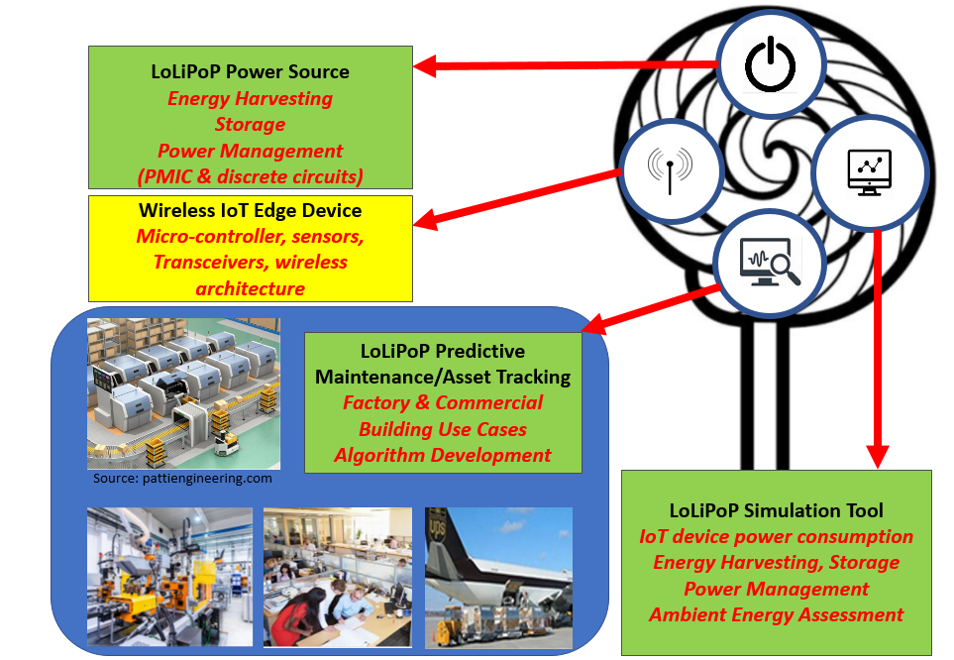

A series of disruptive long battery life-enabling platforms
Lifespan >5 years, in some cases, offering full power autonomy

Slide 29

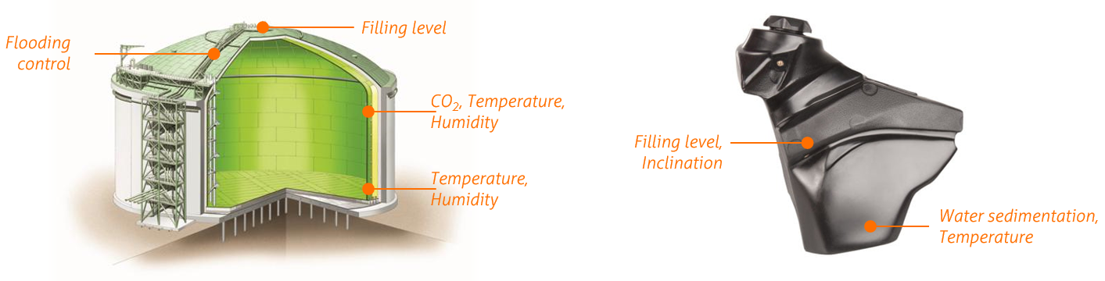

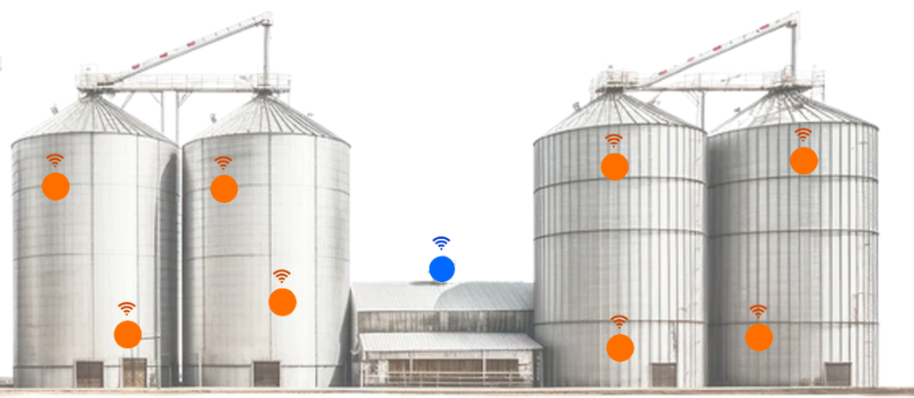
LOLIPOP-IOT UC7&9: Introduction
UC7
UC9
Condition Monitoring of bulk material containers for preventing fermentation or spontaneous combustion processes.
Condition monitoring of filling levels, water sedimentation, and temperature in motorcycle fuel tanks.
Validation scope
Deployment and performance test in-house/labs
Test in real-case scenarios i.e., industrial bulk containers

Slide 30
LOLIPOP UC7&9: Gateway
UC7
UC9

Slide 31
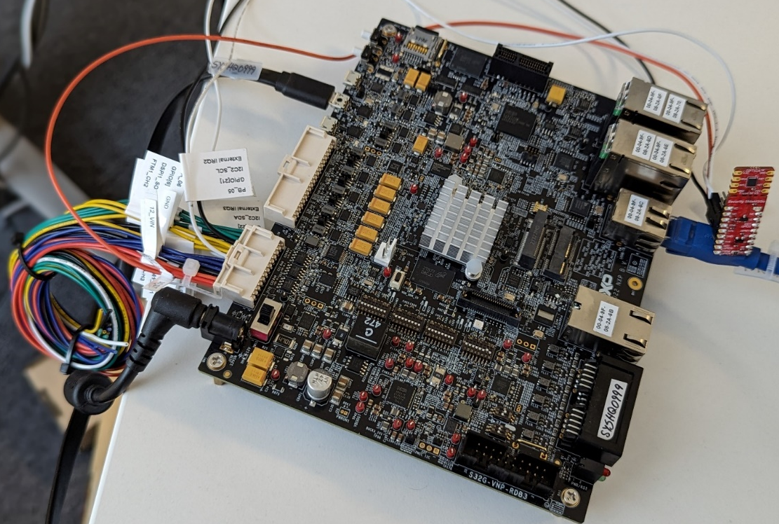
Lolipop IoT UC7&9: WORK IN PROGRESS
NXP S32G-VNP-RDB3
Octal Arm® Cortex®-A53 cores
integrated board for:
vehicle computer
service-oriented gateways (SoG)
domain control applications,
high-performance processing
safety and security applications
HSM (Root of Trust)
Crypto Key Management
Encryption and Decryption
Digital Signatures
Sensors
Mioty
Bluetooth
Ethernet
Use Cases:
Protect the communication
Secure the update (SOTA)
Secure the boot process (e.g. secure boot)

Slide 32
Safe Secure Smart Cloud/Edge Gateway
Open Challenges & Questions

Slide 33
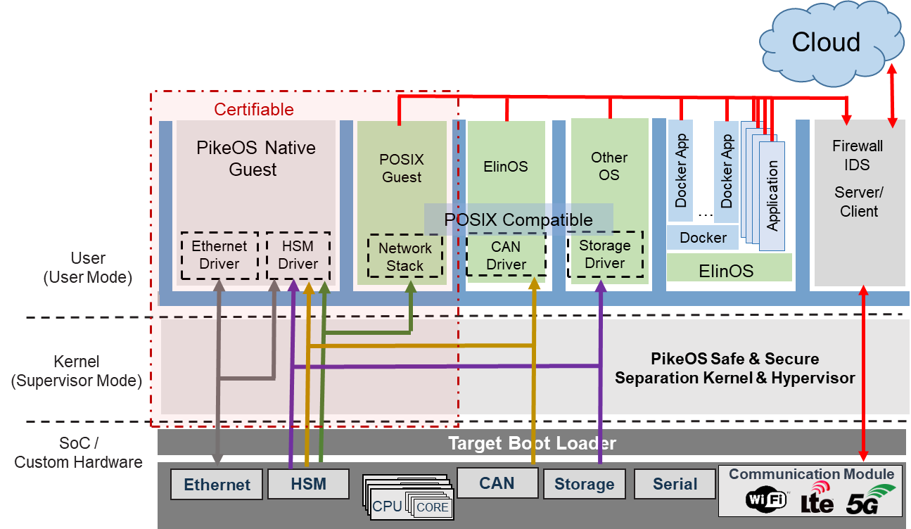
Safe Secure Smart Cloud Gateway
Security by Separation Kernel
Multiple Independent Layers of Security (MILS)

Slide 34
Safe Secure Smart Cloud Gateway Application Example
Open Issues/Challenges
Heterogeneous devices & protocols need to have homogeneity to be delivered to the cloud in a seamless manner

Slide 35
Safe Secure Smart Cloud Gateway QUESTIONS (1)
Security and Safety
Ensure end-to-end encryption and data integrity
Best practices for securing communication channels (e.g., interference)
Access control and authentication mechanisms?
Safety-critical standards (e.g., ISO 26262, IEC 61508) Compliance & Certification
Reliability and Resilience
Fault-tolerant system to handle hardware/software failures?
Availability and downtime in industrial and medical applications.
Real-time monitoring and predictive maintenance of connected devices.
Scalability and Performance
Handle large number of connected devices
Optimize performance for real-time data processing
Implications of scalability on latency and throughput (e.g., in mission-critical applications)
Interoperability and Standards
Compatibility with IoT protocols and standards (e.g., MQTT, CoAP, OPC UA).
Seamless integration with existing systems (e.g., industrial and medical equipment)
Interoperability across vendors and platforms

Slide 36
Safe Secure Smart Cloud Gateway QUESTIONS (2)
Data Management and Analytics
Secure and efficient data storage, retrieval, and processing.
AI and ML for predictive analytics and decision-making (e.g., in industrial applications)
Data privacy and compliance with (e.g., GDPR, EU Cyber Resilience Act).
Network and Connectivity
Reliable and secure connectivity in harsh environments (e.g., trains, satellites).
Network latency and bandwidth limitations.
Optimize network traffic for real-time applications
Resource Management
Limited computational and memory resources in embedded systems.
Dynamic resource allocation and scheduling under an RTOS environment
Power management and extending battery life in IoT devices.
Development and Deployment
Lifecycle of secure and safe IoT applications.
(S)OTA updates and patch management (e.g., in industrial and medical contexts)
Continuous integration and deployment in a safety-critical environment.
Regulatory and Compliance
Different regulatory environments (e.g., medical, industrial, and aerospace applications)
Compliance with safety and security standards (e.g., countries, industries)
Certification and validation requirements for critical systems

Slide 37






QUESTIONS OR COMMENTS?
SYSGO GmbH Am Pfaffenstein 8 55270 Klein-Winternheim Germany
Phone: +49 6136 99480 E-Mail: info@sysgo.com .......................................................
Sales Contact sales@sysgo.com
george.violettas@sysgo.com
Subscribe, Like and Follow:
www.sysgo.com/newsletter
...............................................................
www.sysgo.com/twitter
www.sysgo.com/linkedin
www.sysgo.com/youtube
www.sysgo.com
Notes:
About SYSGO
SYSGO is the leading European manufacturer of embedded operating systems, supporting safety and security critical applications in the aerospace, automotive, railway and IIoT industries for more than 25 years. The company develops and maintains PikeOS®, the world's first SIL 4 certified real-time operating system and hypervisor on multi-core. SYSGO's PikeOS separation kernel has been certified according to Common Criteria EAL 3+ and is currently the only real-time operating system worldwide that holds a CC certification for its separation performance. Also being certified to the strictest safety standards such as IEC 61508, EN 5018 and ISO 26262, PikeOS® enables application development following the “Safe & Secure by Design" principle. For less critical systems, SYSGO also offers ELinOS, an industrial grade Linux distribution with real-time extensions for embedded systems.
SYSGO works closely with customers throughout the product life cycle and supports clients such as Samsung, Airbus, Thales, Continental, etc. in the formal certification of software according to international standards for functional safety and IT security. Headquartered in Klein-Winternheim near Frankfurt, Germany, SYSGO has subsidiaries in France, the Czech Republic and the UK and maintains a world-wide distribution network. The company is part of the European Thales Group.
For further information please join our LinkedIn group "Certified RTOS" https://www.linkedin.com/groups/8738146/ or visit us at https://www.sysgo.com/ Company Movie (in EN, DE, FR) can be seen here:
https://www.youtube.com/watch?v=x5YUhbKTXbA&feature=youtu.be
SYSGO knowledge center:
https://www.sysgo.com/services/knowledge-center/

